Slide 1



Coastal erosion and flooding
How can a Community
Transition Plan (CTP) help?
By Marnix de Vriend for Haskoning
Coordinator Coastwise Community Transition Plan Walcott, Bacton and Weybourne
Parish Council Weybourne, 3rd September 2025

Slide 2

Contents of presentation
Who is Haskoning?
What is Coastwise (Transition Plan project?
What are the project objectives?
How will we try to achieve them?
How can we work together?

Slide 3

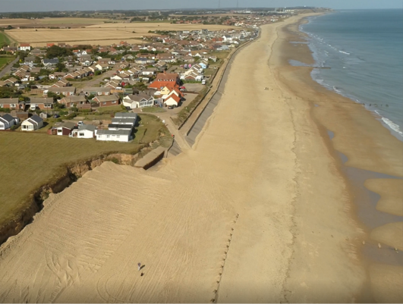
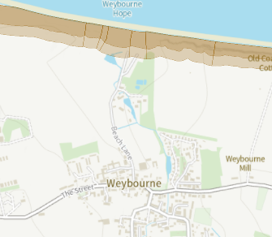
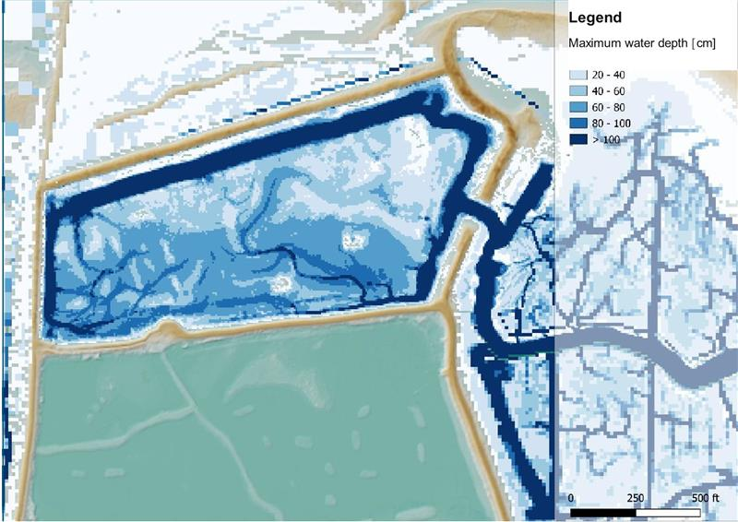
Haskoning
Consulting engineers, Dutch background with UK home market
Very active on the Norfolk coast:
  Bacton Sandscaping: idea, plan, design, monitoring
  Shoreline Management Plans and coastal erosion predictions
  Helping Wells Harbour and various coastal landowners (Holkham, RSPB, Burnham community) plan for coastal change

Slide 4

What is the Coastwise CTP?
Coastal erosion and flooding accelerated by climate change
Adapt, manage retreat , try to link it to community demands
Instead of wait and see
TP and its Action Plan: community-owned

Slide 5
Project Objectives
Adapt to cliff erosion caused by stronger waves and more rainfall
Adapt to flooding (when caused by high tides)?
Community based and community owned - but also deliverable: NNDC-adopted and fundable
Set an example for elsewhere

Slide 6
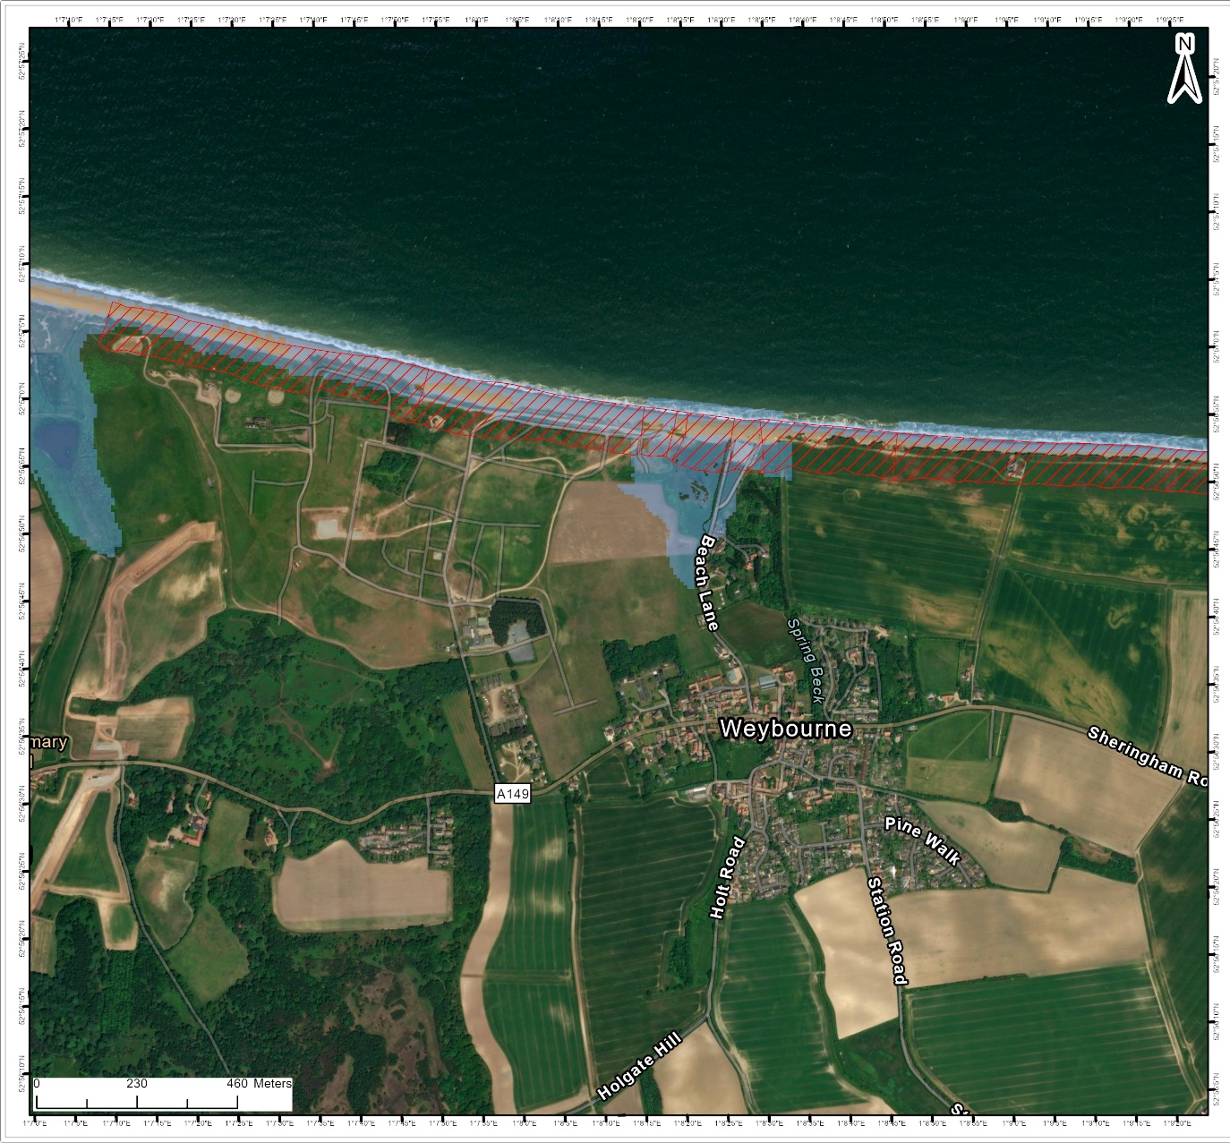
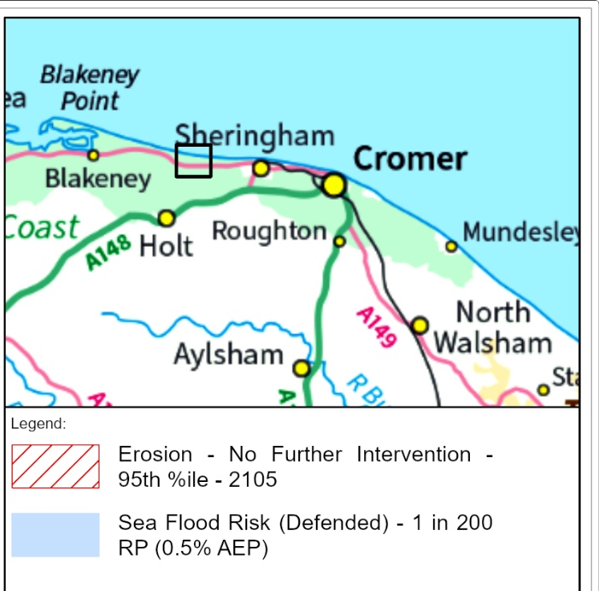
What might (not) occur?

Slide 7
How?
Methods and techniques: develop and appraise
Based on the communities’ knowledge
Linking to community desires
Preferred alternative or more options to choose from?

Slide 8
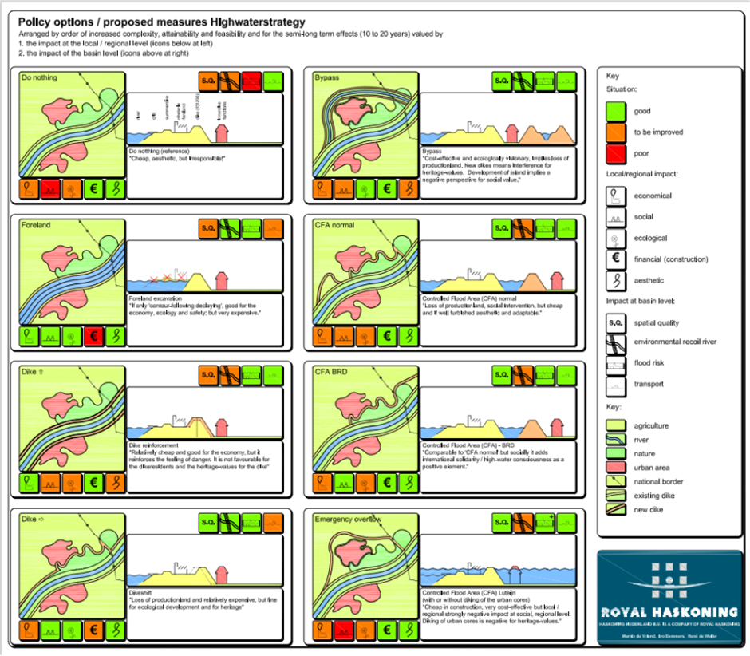
Options and appraisal: an example

Slide 9
How to work together?
Walkin-events started 1st September: show maps slide 6
Combined Coastwise/ TP Cafés (follow-up of June 2024) October/ December
Stakeholder encounters
Use local platforms for communication
Try to be a part of the community
Listen and respond
What is in it for Weybourne?

